Slide 1

A PROPOSAL ON
NON-AUTOREGRESSIVE TRANSFORMER TEXT-TO-SPEECH (TTS) MODEL FOR LOW-RESOURCE NEPALI: BALANCING EFFICIENCY AND PROSODY
RAJCHAUTARA - 32, POKHARA
SUBMITTED BY SUBMITTED TO
Nirajan Dhakal Suresh Raj Dhakal
BIT PROGRAM
2025

Slide 2
TABLE OF CONTENTS
Introduction
Literature Review
Methodology
Estimated Budget
Timeline of Operation
Ethical Considerations
Expected Outcomes
Conclusion
References

Slide 3
Introduction
Nepali TTS Gap: Despite 17+ million speakers, Nepali lacks robust Text-to-Speech (TTS) systems, creating a significant technological access gap.
Linguistic Complexity: Nepali's tonal nature and diverse dialects (Eastern, Western, Central) pose major challenges for accurate and natural speech synthesis.
Low-Resource Constraints: Limited availability of high-quality, annotated Nepali speech data hinders the development of effective TTS models.
Autoregressive Model Limitations: Traditional TTS models, like autoregressive ones, are computationally expensive and inefficient for low-resource languages like Nepali.
Proposed Solution: Non-Autoregressive Transformers: Utilizing non-autoregressive transformer architectures to enhance speed and resource efficiency while maintaining prosodic accuracy.
Community-Driven & Inclusive Development: Emphasizing community collaboration for data curation and aiming to democratize technology access and preserve Nepali linguistic heritage.

Slide 4
Literature Review: Theoretical Review
Transformers (Vaswani et al., 2017): Parallel processing, speed.
FastSpeech (Ren et al., 2019): Duration-based, faster synthesis.
VITS (Kim et al., 2021): High-fidelity, end-to-end VAE.
StyleTTS 2 (Liu et al., 2022): Advanced prosody, naturalness.
Key Idea: Shift to non-autoregressive models for efficiency.

Slide 5
Literature Review: Empirical Review
Transfer Learning (Jia et al., 2021): Hindi to Nepali success.
Self-Supervised (WavLM- Chen et al., 2021): Unlabeled data power.
Zero-Shot (XTTS- Casanova et al., 2022): Multilingual adaptation.
Key Idea: Leveraging existing data for under-resourced languages.
Impact: Increased accessibility.

Slide 6
Methodology
Data Collection and Preparation:
Multimodal dataset combining text and speech data.
NepaliText Corpus: 13 million text sequences.
Audio data: recorded using textual data from NepaliText Corpus.
Community Collaboration: Native speakers across Nepal's Eastern, Western, and Central regions will contribute dialect-specific recordings.
Synthetic Data Generation: using the rule-based synthesizer espeak-ng.
Data Preprocessing
Text Normalization: Expanding numbers, abbreviations, and symbols into their spoken equivalents.
Forced Alignment: using the Montreal Forced Aligner (MFA; McAuliffe et al., 2017).

Slide 7
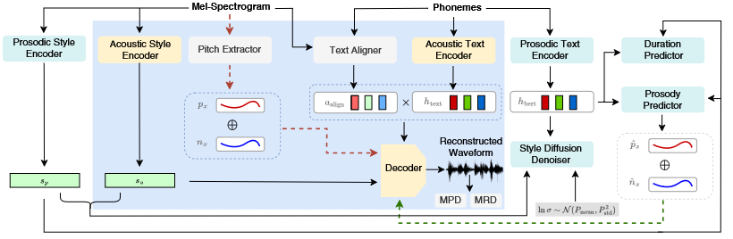
Methodology
Model Architecture
Figure 1: Architecture of the proposed Text-To-Speech model.
Notes:
Text Encoder: Converts input graphemes into linguistic features using a transformer with relative positional encoding (Shaw et al., 2018).
Duration Predictor: Estimates phoneme durations to enable parallel decoding.
Prosody Model: Captures pitch (F0), energy variations at phoneme, word, and sentence levels.
HiFi-GAN Vocoder: Synthesizes high-fidelity waveforms from mel-spectrograms.

Slide 8
Methodology
Training Pipeline:
Pretraining on a Hindi TTS dataset using the XTTS framework (Casanova et al., 2022).
Fine-tuning specifically for Nepali datasets.
Evaluation:
Subjective Evaluation: Native speakers will rate synthetic speech on a 1-5 Mean Opinion Score (MOS) scale.
Objective Metrics: Word Error Rate (WER) and Prosody Distance.

Slide 9
Estimated Budget
Category | Amount (Rs.)
Investigators (3) + Linguistic Consultants (3) | 800,000
Cloud Computing Credits | 1,000,000
Conference Travel, Registration and Publication Fees | 400,000
Contingency | 50,000
Total | 2,250,000
Table 1: Estimated budget costing for the project. This table in the slide does not represent true values here. Please refer to the proposal document for accurate representation of estimated budget.

Slide 10
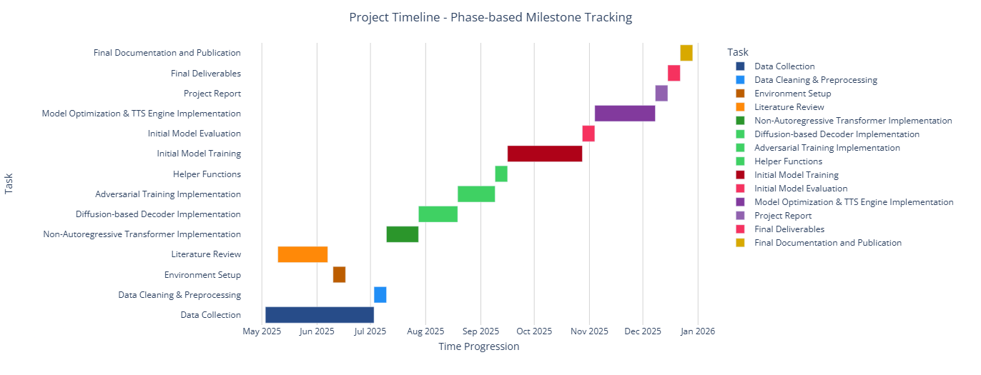
Timeline of Operation
Figure 2: Gantt Chart showing the timeline of the project.

Slide 11
Ethical Considerations
Data Privacy and Informed Consent:
All participants will provide informed consent.
No personal identifying information will be collected without explicit consent.
Cultural Sensitivity and Respect:
The research team will engage closely with linguistic communities.
Data collection and model development will respect cultural and linguistic nuances.
Open-Source Contribution and Accessibility:
The TTS model, datasets, and code will be released under an open-source license.
Ensures that its outcomes are accessible to the widest possible audience.
Dual Use and Misuse:
The research team will implement safeguards against potential misuse.
Users will be educated about potential misuses.

Slide 12
Expected Outcomes
Speech Quality:
Mean Opinion Score (MOS) ≥ 4.0.
Ensures speech is indistinguishable from human speech in terms of naturalness and intelligibility.
Speaker Embeddings for Dialects:
Supports Eastern, Western, and Central Nepali dialects.
Allows users to choose the preferred pronunciation style, enhancing linguistic accuracy and cultural representation.
Computational Efficiency:
Performs real-time inference on low-cost hardware.
Accessible and affordable for underserved communities in Nepal.
Open-Source Code Release:
Codebases, datasets, and model weights released under an open-source license.
Fosters collaboration with researchers, educators, and developers globally.

Slide 13
Conclusions
The proposal presents a plan to develop a Nepali Text-to-Speech (TTS) system.
The project will address both technological and linguistic challenges.
It will integrate advanced machine learning with linguistic expertise.
The project will prioritize efficiency, prosody, and dialect inclusivity.
It will also aim to democratize speech technology for Nepali speakers.
The project will serve as a model for other underrepresented languages, contributing to global NLP research.

Slide 14
References
Casanova, E., Weber, J., Shulby, C., Junior, A. C., Gölge, E., & Ponti, M. A. (2022). YourTTS: Towards zero-shot multi-speaker TTS and zero-shot voice conversion for everyone. arXiv preprint arXiv:2112.02418. https://doi.org/10.48550/arXiv.2112.02418
Chen, S., Wang, C., Chen, Z., Wu, Y., Liu, S., Chen, Z., ... & Wei, F. (2022). WavLM: Large-scale self-supervised pre-training for full stack speech processing. IEEE Journal of Selected Topics in Signal Processing, 16(6), 1505–1518. https://doi.org/10.1109/JSTSP.2022.3188113
IRIISNEPAL. (2023). Nepali-Text-Corpus [Dataset]. Hugging Face. https://huggingface.co/datasets/IRIISNEPAL/Nepali-Text-Corpus
Jia, Y., Zhang, Y., Weiss, R. J., Shen, J., Ren, F., Chen, Z., ... & Wu, Y. (2021). Transfer learning for low-resource TTS using global and local feature embeddings. Interspeech 2021, 1927–1931. https://doi.org/10.21437/Interspeech.2021-117
Kim, J., Kong, J., & Son, J. (2021). VITS: Conditional variational autoencoder with adversarial learning for end-to-end text-to-speech. Proceedings of the 38th International Conference on Machine Learning (ICML), 5560–5570. https://proceedings.mlr.press/v139/kim21f.html
Kong, J., Kim, J., & Bae, J. (2020). HiFi-GAN: Generative adversarial networks for efficient and high-fidelity speech synthesis. Advances in Neural Information Processing Systems, 33, 17022–17033. https://proceedings.neurips.cc/paper/2020/hash/c5d736809766d46260d816d8dbc9eb44-Abstract.html
Liu, X., Li, M., Wang, Y., Wu, X., Meng, L., & Qin, T. (2022). StyleTTS 2: Human-level text-to-speech through style diffusion and adversarial training. arXiv preprint arXiv:2212.04421. https://doi.org/10.48550/arXiv.2212.04421
McAuliffe, M., Socolof, M., Mihuc, S., Wagner, M., & Sonderegger, M. (2017). Montreal Forced Aligner: Trainable text-speech alignment using Kaldi. Interspeech 2017, 498–502. https://doi.org/10.21437/Interspeech.2017-1386

